Slide 1
Prompt Engineering
CS XXX: Introduction to Large Language Models

Slide 2
The basic ingredients of a prompt
An essential part of working with text-generative LLMs is prompt engineering. By carefully designing our prompts we can guide the LLM to generate desired responses.
Prompt engineering is more than designing effective prompts. It can be used as a tool to evaluate the output of a model as well as to design safeguards and safety mitigation methods. This is an iterative process of prompt optimization and requires experimentation. There is not and unlikely will ever be a perfect prompt design.

Slide 3
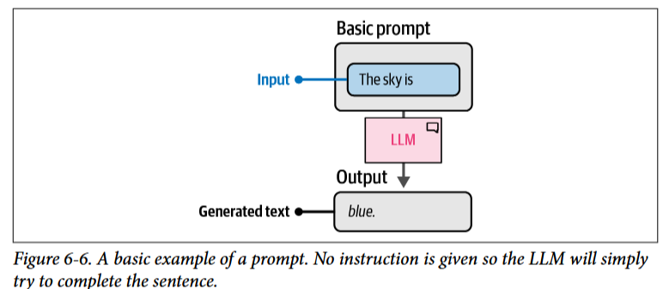
The basic ingredients of a prompt
An LLM is a prediction machine. Based on a certain input, the prompt, it tries to predict the words that might follow it. At its core the prompt does not need to be more than a few words to elicit a response from the LLM.

Slide 4
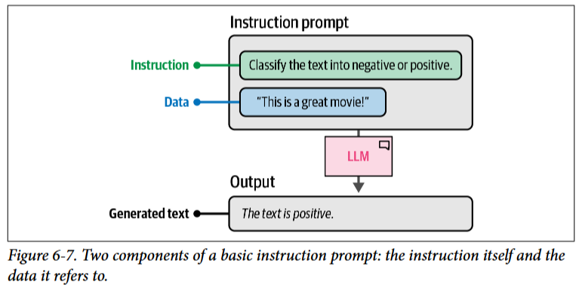
The basic ingredients of a prompt
We generally approach prompt engineering by asking a specific question or task the LLM should complete. To elicit the desired response, we need a more structured prompt.
For example, we could ask the LLM to classify a sentence into either having positive or negative sentiment. This extends the most basic prompt to one consisting of two components—the instruction itself and the data that relates to the instruction.

Slide 5
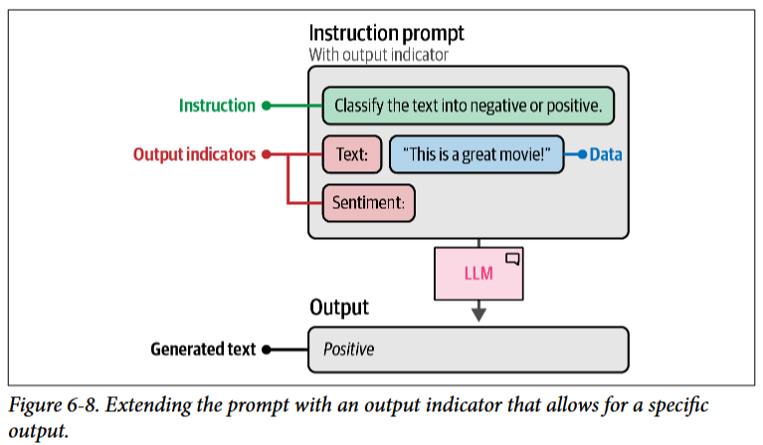
The basic ingredients of a prompt
More complex use cases might require more components in a prompt. For instance, to make sure the model only outputs “negative” or “positive” we can introduce output indicators that help guide the model. In Figure 6-8, we prefix the sentence with “Text:” and add “Sentiment:” to prevent the model from generating a complete sentence. Instead, this structure indicates that we expect either “negative” or “positive.” Although the model might not have been trained on these components directly, it was fed enough instructions to be able to generalize to this structure.

Slide 6
The basic ingredients of a prompt
We can continue adding or updating the elements of a prompt until we elicit the response we are looking for. We could add additional examples, describe the use case in more detail, provide additional context, etc. These components are merely examples and not a limited set of possibilities. The creativity that comes with designing these components is key.

Slide 7
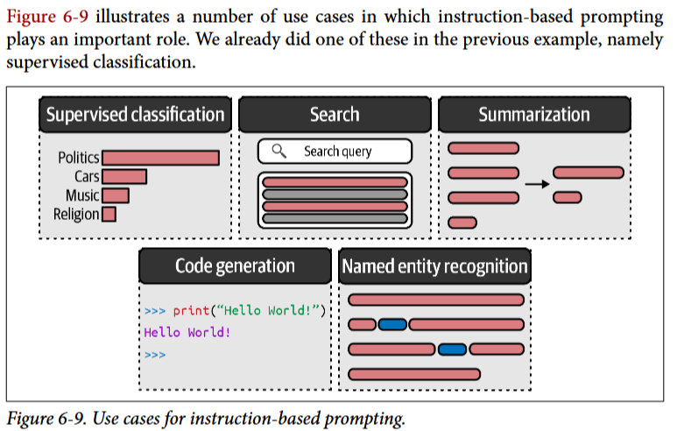
Instruction based prompting
Prompting is often used to have the LLM answer a specific question or resolve a certain task. This is referred to as instruction-based prompting.

Slide 8
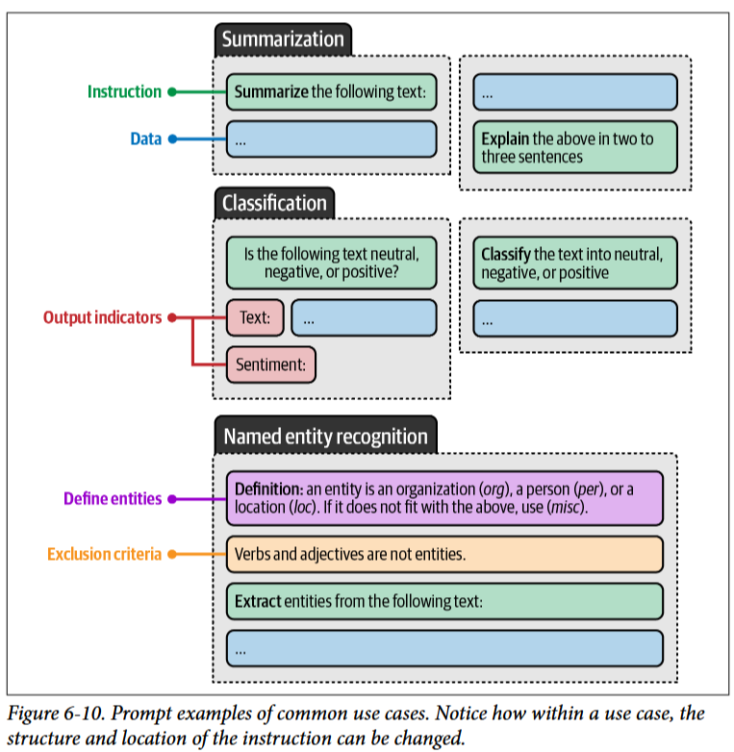
Instruction based prompting
Each of these tasks requires different prompting formats and more specifically, asking different questions of the LLM. Asking the LLM to summarize a piece of text will not suddenly result in classification.

Slide 9
Instruction based prompting
Although these tasks require different instructions, there is actually a lot of overlap in the prompting techniques used to improve the quality of the output.
Specificity: Accurately describe what you want to achieve. Instead of asking the LLM to “Write a description for a product” ask it to “Write a description for a product in less than two sentences and use a formal tone.”
Hallucination: LLMs may generate incorrect information confidently, which is referred to as hallucination. To reduce its impact, we can ask the LLM to only generate an answer if it knows the answer. If it does not know the answer, it can respond with “I don’t know.”
Order: Either begin or end your prompt with the instruction. Especially with long prompts, information in the middle is often forgotten. LLMs tend to focus on information either at the beginning of a prompt (primacy effect) or the end of a prompt (recency effect).
Specificity is arguably the most important aspect. By restricting and specifying what the model should generate, there is a smaller chance of having it generate something not related to your use case. For instance, if we were to skip the instruction “in two to three sentences” it might generate complete paragraphs. Like human conversations, without any specific instructions or additional context, it is difficult to derive what the task at hand actually is.

Slide 10
Advanced Prompt Engineering
A prompt generally consists of multiple components. In our very first example, our prompt consisted of instruction, data, and output indicators. As we mentioned before, no prompt is limited to just these three components and you can build it up to be as complex as you want.

Slide 11
Advanced Prompt Engineering
advanced components can quickly make a prompt quite complex
Persona: Describe what role the LLM should take on. For example, use “You are an expert in astrophysics” if you want to ask a question about astrophysics
Instruction: The task itself. Make sure this is as specific as possible. We do not want to leave much room for interpretation
Context: Additional information describing the context of the problem or task. It answers questions like “What is the reason for the instruction?”
Format: The format the LLM should use to output the generated text. Without it, the LLM will come up with a format itself, which is troublesome in automated systems.
Audience: The target of the generated text. This also describes the level of the generated output. For education purposes, it is often helpful to use ELI5 (“Explain it like I’m 5”).
Tone: The tone of voice the LLM should use in the generated text. If you are writing a formal email to your boss, you might not want to use an informal tone of voice.
Data: The main data related to the task itself.

Slide 12
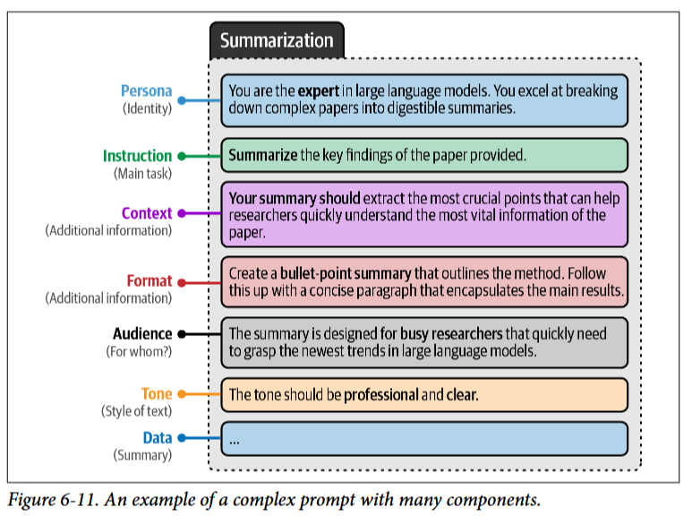
Advanced Prompt Engineering
Let us extend the classification prompt we had earlier and use all of the preceding components.
This complex prompt demonstrates the modular nature of prompting. We can add and remove components freely and judge their effect on the output.

Slide 13
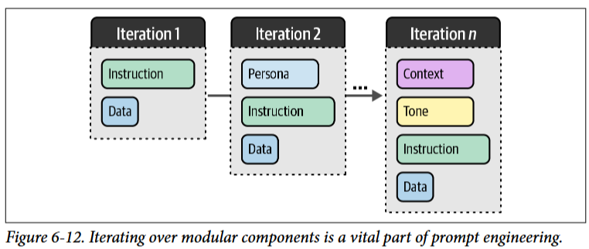
Iterative Improvement
We can slowly build up our prompt and explore the effect of each change.
The changes are not limited to simply introducing or removing components. Their order, as we saw before with the recency and primacy effects, can affect the quality of the LLM’s output. In other words, experimentation is vital when finding the best prompt for your use case. With prompting, we essentially have ourselves in an iterative cycle of experimentation.

Slide 14
In-Context Learning
Although accurate and specific descriptions help the LLM to understand the use case, we can go one step further. Instead of describing the task, why do we not just show the task?
We can provide the LLM with examples of exactly the thing that we want to achieve. This is often referred to as in-context learning, where we provide the model with correct examples.

Slide 15
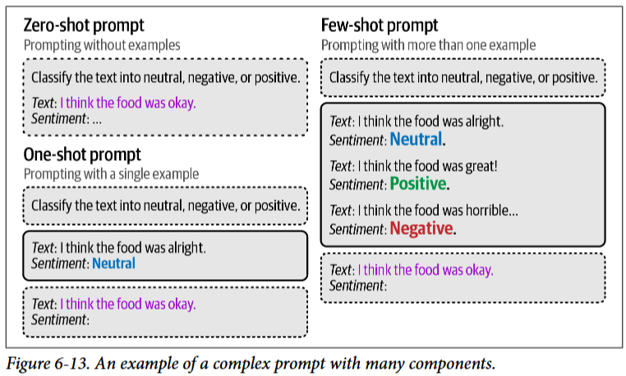
In-Context Learning
In-context learning comes in a number of forms depending on how many examples you show the LLM. Zero-shot prompting does not leverage examples, one-shot prompts use a single example, and few-shot prompts use two or more examples.

Slide 16
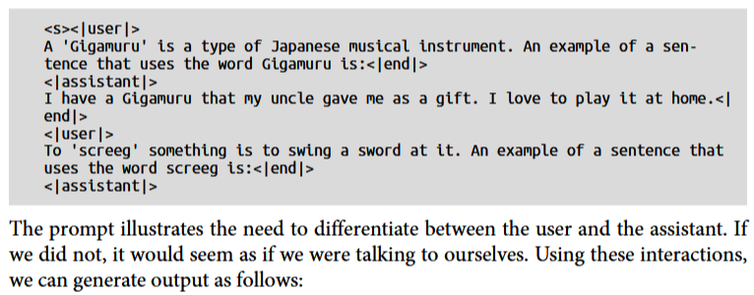
Conversations as Examples
We can assign roles in the prompt to provide an example response to the LLM to show exactly the kind of response we want to achieve. To do so, we will need to differentiate between our question (user) and the answers that were provided by the model (assistant).
one_shot_prompt = [
{
"role": "user",
"content": "A 'Gigamuru' is a type of Japanese musical instrument. An
example of a sentence that uses the word Gigamuru is:“
},
{
"role": "assistant",
"content": "I have a Gigamuru that my uncle gave me as a gift. I love
to play it at home."
},
{
"role": "user",
"content": "To 'screeg' something is to swing a sword at it. An example
of a sentence that uses the word screeg is:"
}
]

Slide 17
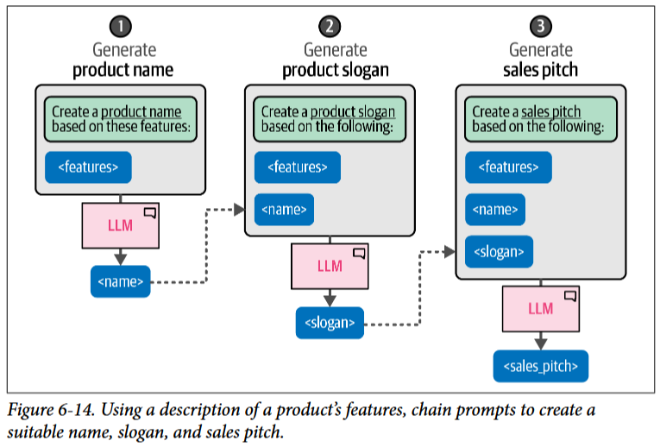
Chain Prompting: Breaking up the Problem
Instead of breaking the problem within a prompt, we can do so between prompts. Essentially, we take the output of one prompt and use it as input for the next, thereby creating a continuous chain of interactions that solves our problem.
To illustrate, let us say we want to use an LLM to create a product name, slogan, and sales pitch for us based on a number of product features. Although we can ask the LLM to do this in one go, we can instead break up the problem into pieces.

Slide 18
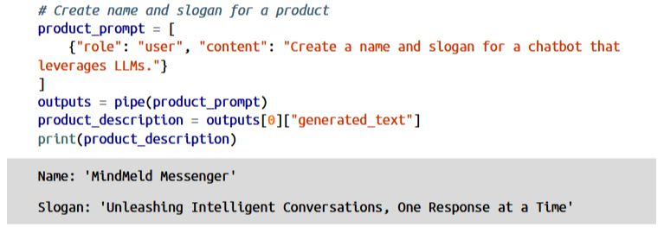
Chain Prompting: Breaking up the Problem
This technique of chaining prompts allows the LLM to spend more time on each individual question instead of tackling the whole problem. Let us illustrate this with a small example. We first create a name and slogan for a chatbot:

Slide 19
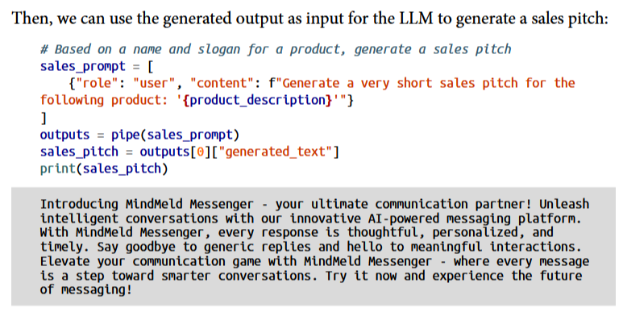
Chain Prompting: Breaking up the Problem
This technique of chaining prompts allows the LLM to spend more time on each individual question instead of tackling the whole problem. Let us illustrate this with a small example.

Slide 20
Reasoning with Generative Models
Reasoning is a core component of human intelligence and is often compared to the emergent behavior of LLMs that often resembles reasoning. We highlight “resemble” as these models, at the time of writing, are generally considered to demonstrate this behavior through memorization of training data and pattern matching.
The output that they showcase, however, can demonstrate complex behavior and although it might not be “true” reasoning, they are still referred to as reasoning capa‐ bilities. In other words, we work together with the LLM through prompt engineering so we can mimic reasoning processes in order to improve the output of the LLM.

Slide 21
Chain-of-Thought: Think Before Answering
The first and major step toward complex reasoning in generative models was through a method called chain-of-thought. Chain-of-thought aims to have the generative model “think” first rather than answering the question directly without any reasoning.

Slide 22
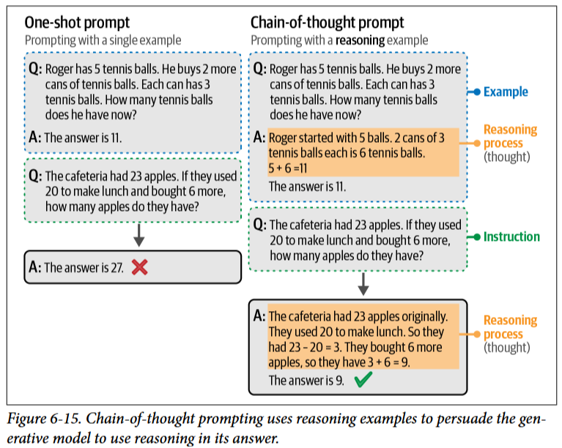
Chain-of-Thought: Think Before Answering
it provides examples in a prompt that demonstrate the reasoning the model should do before generating its response. These reasoning processes are referred to as “thoughts.” This helps tremendously for tasks that involve a higher degree of complexity, like mathematical questions. Adding this reasoning step allows the model to distribute more compute over the reasoning process.

Slide 23
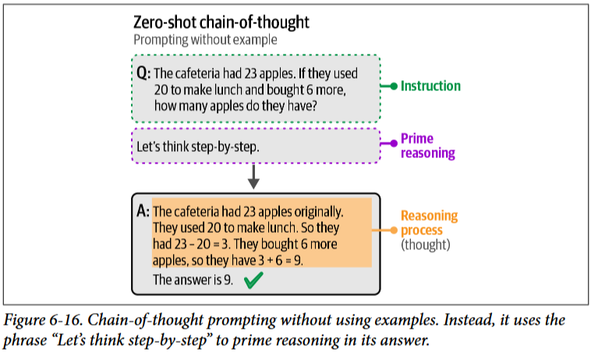
Chain-of-Thought: Think Before Answering
chain-of-thought is a great method for enhancing the output of a generative model, it does require one or more examples of reasoning in the prompt, which the user might not have access to. Instead of providing examples, we can simply ask the generative model to provide the reasoning (zero-shot chain-of-thought). There are many different forms that work but a common and effective method is to use the phrase “Let’s think step-by-step”

Slide 24
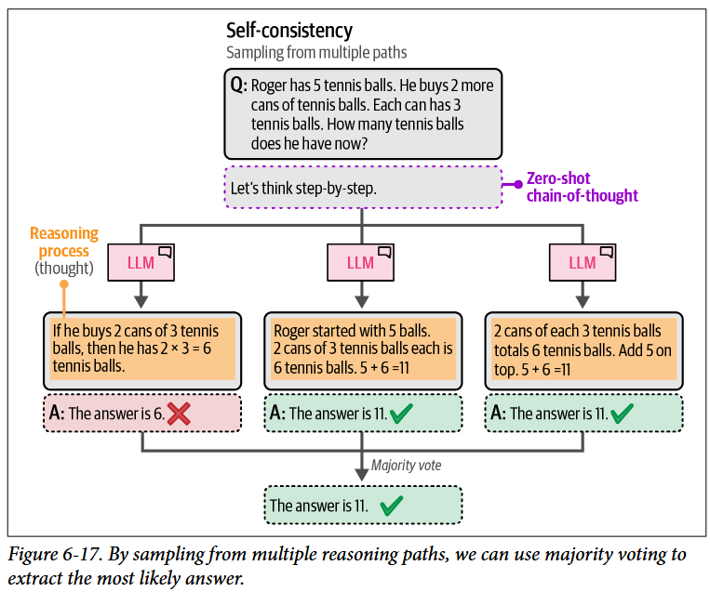
Chain-of-Thought: Think Before Answering
Using the same prompt multiple times can lead to different results. To counteract this self-consistency was introduced. This method asks the generative model the same prompt multiple times and takes the majority result as the final answer.

Slide 25
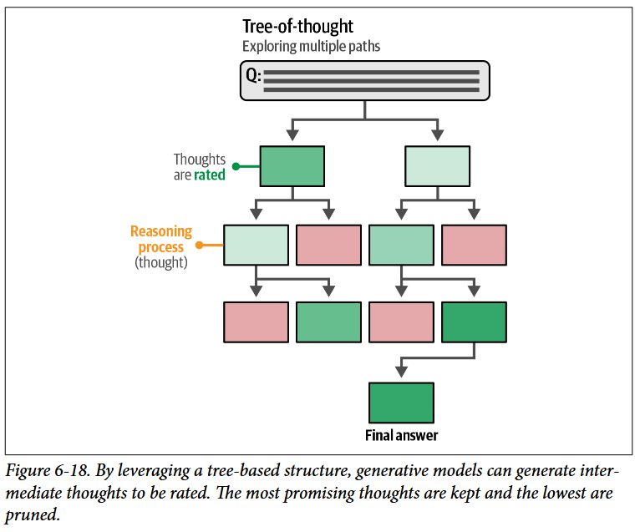
Tree-of-Thought: Exploring Intermediate Steps
Using the same prompt multiple times can lead to different results. To counteract this self-consistency was introduced. This method asks the generative model the same prompt multiple times and takes the majority result as the final answer. An improvement to these approaches can be found in tree-of- thought, which allows for an in-depth exploration of several ideas.
The method works as follows. When faced with a problem that requires multiple reasoning steps, it often helps to break it down into pieces. At each step the generative model is prompted to explore different solutions to the problem at hand. It then votes for the best solution and continues to the next step.

Slide 26
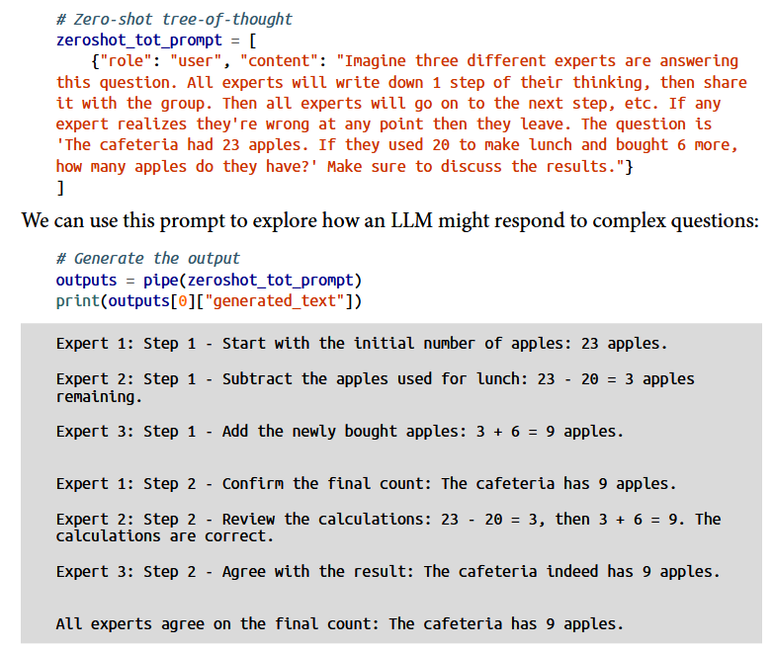
Tree-of-Thought: Exploring Intermediate Steps
Instead of calling the generative model multiple times, we ask the model to mimic that behavior by emulating a conversation between multiple experts. These experts will question each other until they reach a consensus. An example of a tree-of- thought prompt is:

Slide 27
Output Verification
Systems and applications built with generative models might eventually end up in production. When that happens, it is important that we verify and control the output of the model to prevent breaking the application and to create a robust generative AI application.
Reasons for validating the output might include:
Structured output: By default, most generative models create free-form text without adhering to specific structures other than those defined by natural language. Some use cases require their output to be structured in certain formats, like JSON.
Valid output: Even if we allow the model to generate structured output, it still has the capability to freely generate its content. For instance, when a model is asked to output either one of two choices, it should not come up with a third.
Ethics: Some open source generative models have no guardrails and will generate out‐ puts that do not consider safety or ethical considerations. For instance, use cases might require the output to be free of profanity, personally identifiable information (PII), bias, cultural stereotypes, etc.
Accuracy: Many use cases require the output to adhere to certain standards or performance. The aim is to double-check whether the generated information is factually accurate, coherent, or free from hallucination.

Slide 28
Output Verification
Generally, there are three ways of controlling the output of a generative model:
Examples: Provide a number of examples of the expected output.
Grammar: Control the token selection process.
Fine-tuning: Tune a model on data that contains the expected output.

Slide 29
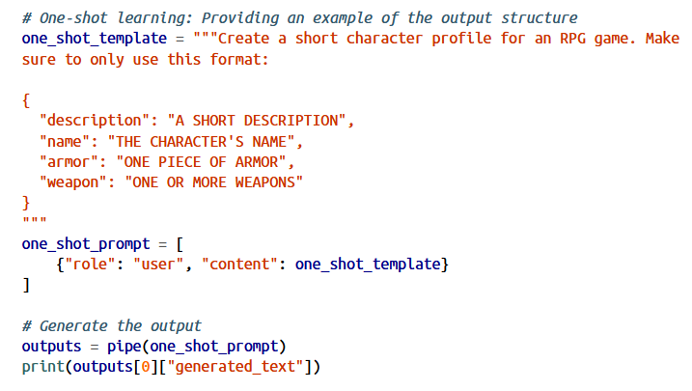
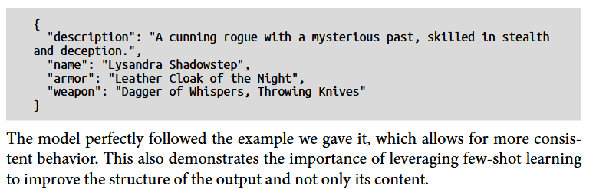
Providing Examples
A simple and straightforward method to fix the output is to provide the generative model with examples of what the output should look like. As we explored before, few-shot learning is a helpful technique that guides the output of the generative model. This method can be generalized to guide the structure of the output as well.

Slide 30
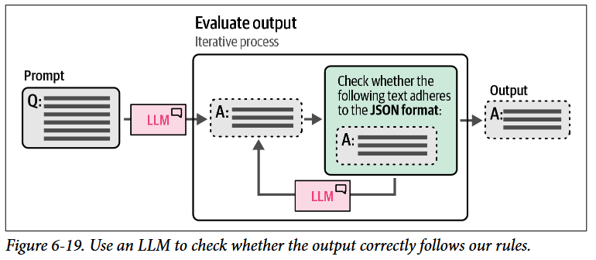
Grammar: Constrained Sampling
Few-shot learning has a big disadvantage: we cannot explicitly prevent certain output from being generated. Although we guide the model and give it instructions, it might still not follow it entirely.
Instead, packages have been rapidly developed to constrain and validate the output of generative models, like Guidance, Guardrails, and LMQL. In part, they leverage generative models to validate their own output

Slide 31
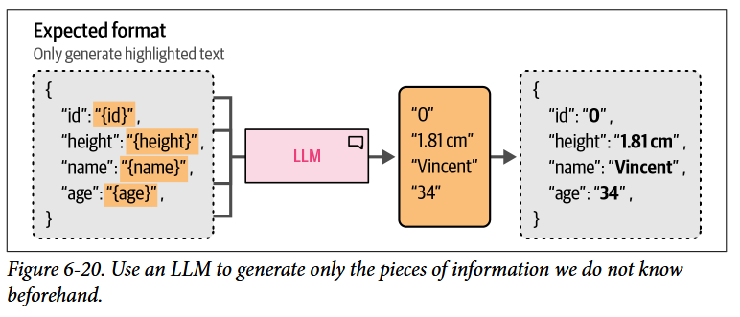
Grammar: Constrained Sampling
Similarly, this validation process can also be used to control the formatting of the output by generating parts of its format ourselves as we already know how it should be structured

Slide 32
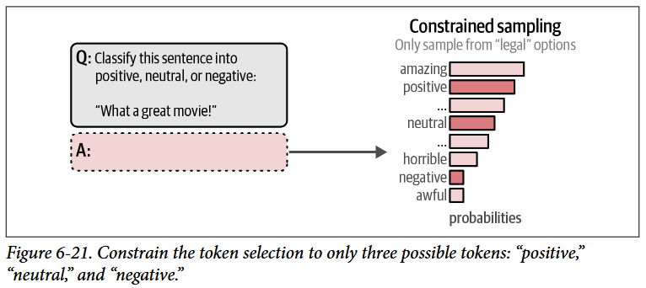
Grammar: Constrained Sampling
When sampling tokens, we can define a number of grammars or rules that the LLM should adhere to when choosing its next token. For instance, if we ask the model to either return “positive,” “negative,” or “neutral” when performing sentiment classification, it might still return something else. by constraining the sampling process, we can have the LLM only output what we are interested in.

